Slide 1
Issues to desktop/laptop version
ouitoo v0

Slide 2
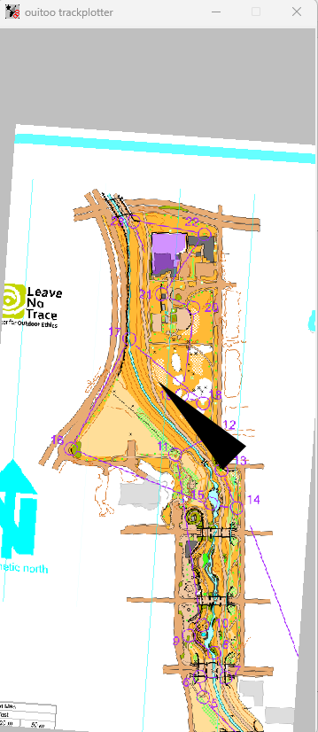
2-26-2025
1
Pointer has to disappear exiting menu_GUI()

Slide 3
2-26-2025
2
Canvas size?
Map has to display completely when rotating the image
(switch from temporary PIL rotate to mat_affine assignment)

Slide 4
2-26-2025
3
Rotation
Rotate the map at menu_GUI exit

Slide 5
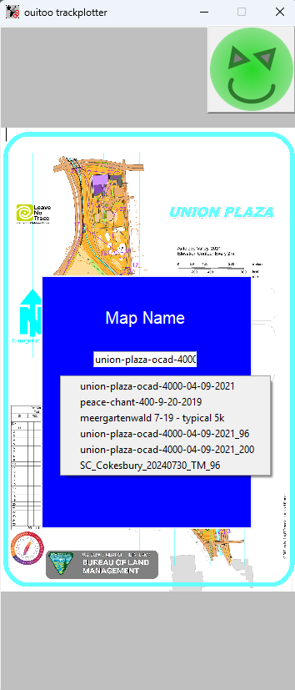
2-26-2025
4
Load image after return button self.count==1
Use popup menu filename

Slide 6
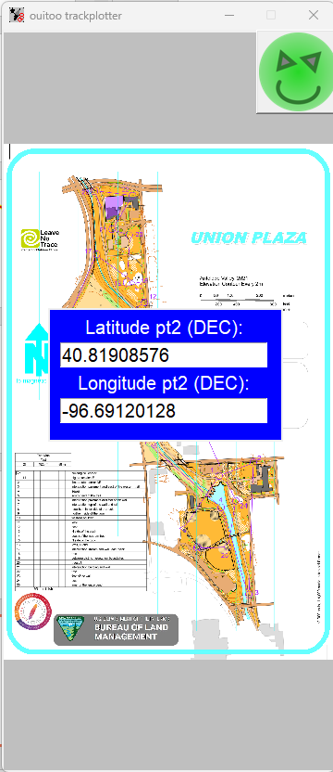
2-26-2025
5
Scale placement (Xpos, Ypos, width, height, font) parameters to the window diagonal
Make return button bg transparent

Slide 7
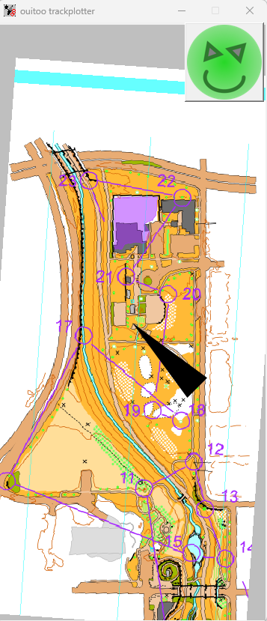
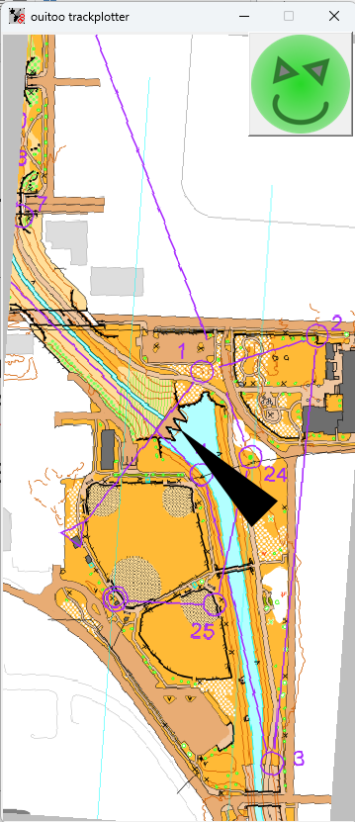
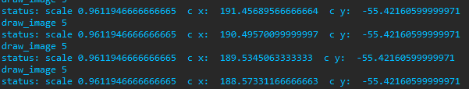
2-26-2025
Point 2 set up
Point 1 set up
6
Take scale into account to generalize the DISTANCE_MAP setting
Refine to pick up the coordinates at the center of the map, and to know the nw corner coordinate at any instant

Slide 8
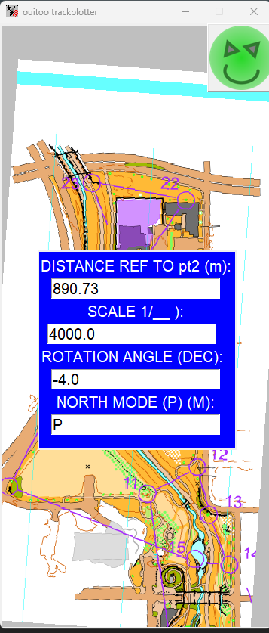

2-26-2025
7
Keep scale and display a text “Scale is: scale at DPI dpi” as a label with transparent bg
“Current Scale: scale” with a delay and disappearing ?

Slide 9
2-26-2025
Spreadsheet calculation
based on 96% zoom picking
and delta image corners
X0 | 497.7772 | X2 | 189.2337 |  | 308.5435 | 95199.08
Y0 | 724.7137 | Y2 | -55.7764 |  | 780.4901 | 609164.7
 |  |  |  |  |  | 704363.8
 |  |  |  |  | px | 839.2639
 |  |  |  |  | in | 8.742332
 |  |  |  |  | m | 0.222055
 |  |  |  |  | m terrain | 888.2209
 |  |  |  |  | m distance ref | 890.73
 |  |  |  |  | deviation | 1.002825
8 (after 2-26-2025-#6)
Once 2-26-2025-#6 is fixed use placement coordinates to plot a place icon and track icon and so on with the test case API_GPS() list of LAT, LONG points
Use conversion function GPS_to_SCREEN(self, current_LAT, current_LONG)
Menu_GUI() output
Self.Y0
Self.X2
Self.X0
Self.Y2

